Slide 1
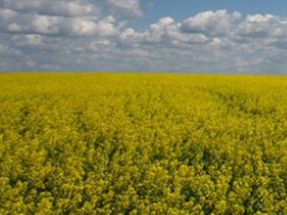
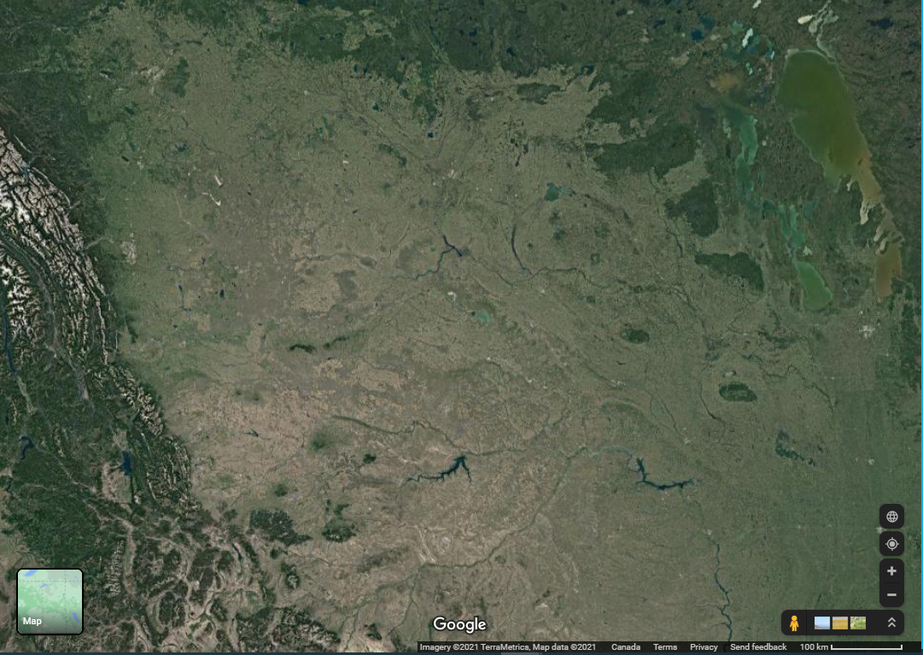


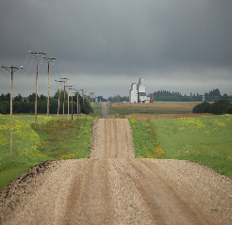
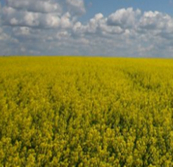
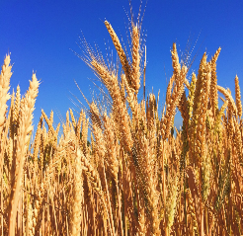
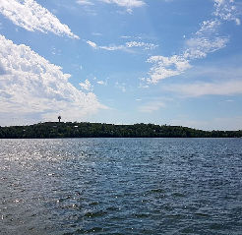
Land and water
– Supporting productive agricultural lands, and healthy waters by keeping nutrients on the land –
Helen Baulch
Images:
Google earth
https://pxhere.com/en/photo/13555
https://www.flickr.com/photos/jeremyhiebert/3698577995
https://commons.wikimedia.org/wiki/File:Leney,_Saskatchewan_2015.jpg
https://commons.wikimedia.org/w/index.php?title=User:Canadaadanac&action=edit&redlink=1
KrazyTea https://commons.wikimedia.org/wiki/File:Killarney_Lake,_Manitoba_2.jpg
Notes:
All right – today I want to talk to you about land and water – and really focus on agriculture, nutrients, and water quality.
I want to make an argument that we have some work ahead of us – to manage two really important goals – of managing productive agricultural lands, while maintaining healthy waters.
Images:
Google earth
https://pxhere.com/en/photo/13555
https://www.flickr.com/photos/jeremyhiebert/3698577995
https://commons.wikimedia.org/wiki/File:Leney,_Saskatchewan_2015.jpg
https://commons.wikimedia.org/w/index.php?title=User:Canadaadanac&action=edit&redlink=1
KrazyTea https://commons.wikimedia.org/wiki/File:Killarney_Lake,_Manitoba_2.jpg

Slide 2
– 2 key points –
Notes:
And right at the outset, I want to tell you I have two key points I want to make.

Slide 3
– there is a problem –
– we have some pragmatic, workable options –
Notes:
I want to tell you that there is a problem.
And, I want to tell you we have some pragmatic, workable options to think about.

Slide 4
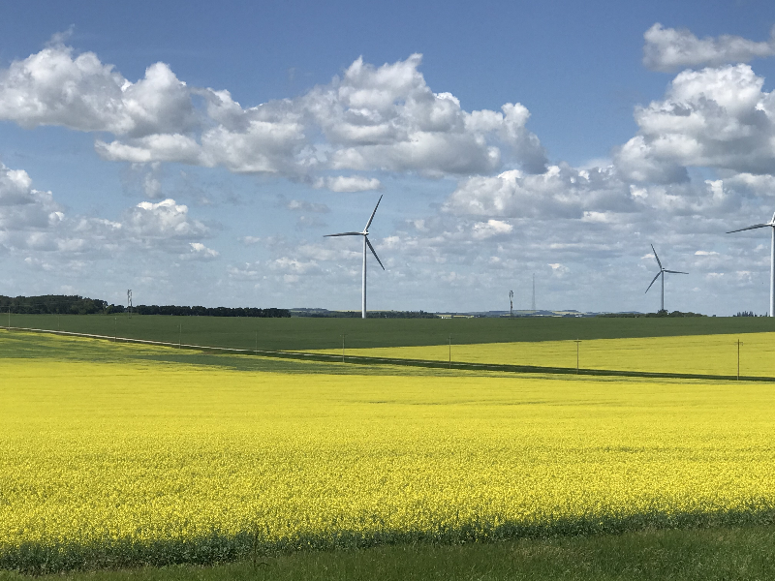
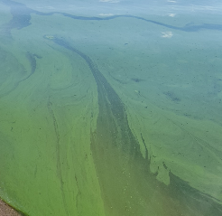
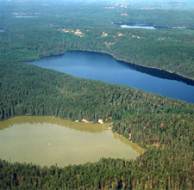

– the problem –
-- The problem--
Water quality issues such as blooms are a major concern in the prairies.
Blooms here are natural, but there is widespread evidence they are worsening.
Nutrients are contributing to the problem.
Notes:
Let’s start with the problem.
Images like this one on the top will be familiar to many. Water quality issues such as blooms are a common issue – and a major concern on the prairies.
I want to note that blooms are natural – they have existed here for hundreds and hundreds of years. But there is widespread evidence they are worsening.
And that’s a big concern. They can lead to fish kills and effects on oxygen, they impede our recreational use – but perhaps the most concerning factor, is they can be toxic.
And – we know that nutrients are contributing to this problem of blooms. Interestingly – we’ve known this for decades – and we’ve seen this demonstrated through work, at the Experimental Lakes Area in northwestern Ontario – where we see the impacts of nutrients – on the lake in the left – and no added nutrients on the lake on the right.
Nutrients have a number of sources. There are natural nutrients, and those that humans add. In our landscape, agriculture is a really important source of nutrients -- . There are others though – sewage for example can also be important.

Slide 5
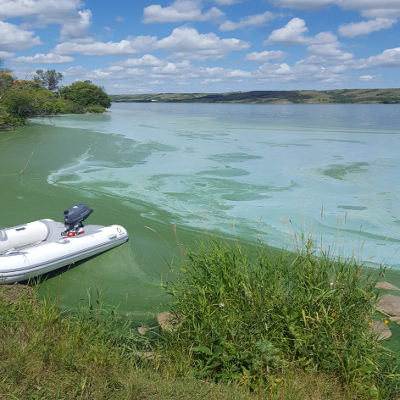


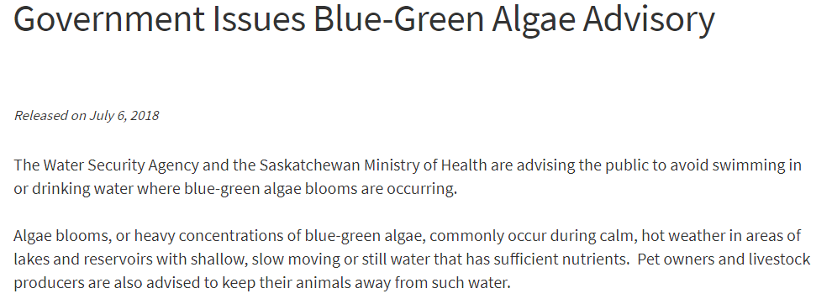


– the problem –
CTV news:
Notes:
As noted -- nutrient related issues and bloom issues are widespread in the prairies. We see these types of headlines every year. Toxic algal blooms, blue green algae – and advisories popping up throughout much of the prairies. So it’s a big issue.

Slide 6
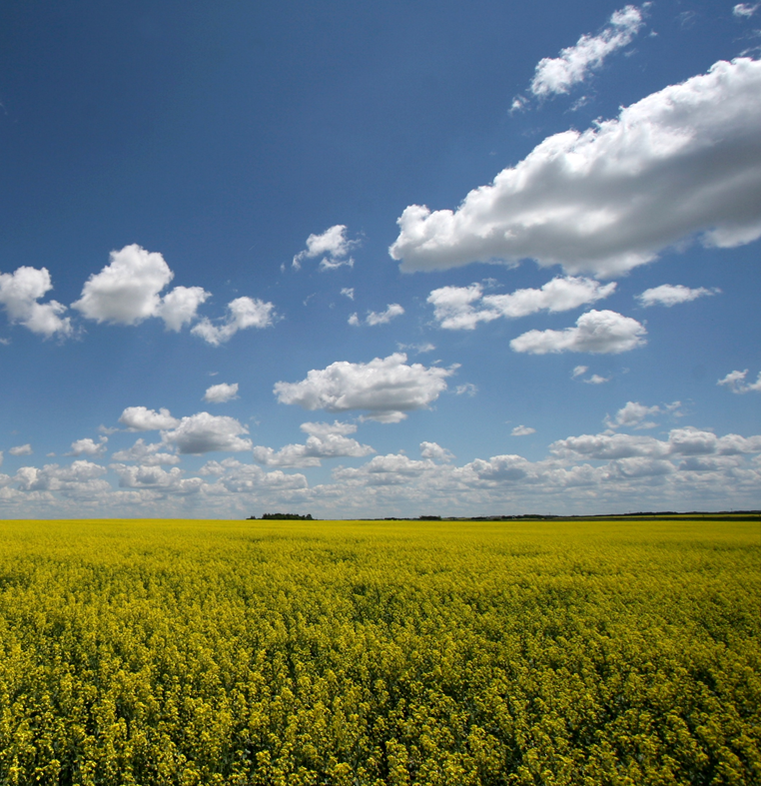
Most producers are managing nutrients very carefully.
Image: Jeremy Hiebert (https://www.flickr.com/photos/jeremyhiebert/3698577995)
Notes:
But let’s step back from the problem for a second -- I want to emphasize one key point.
Most producers are doing managing nutrients very, very carefully.
So – why do we have these water quality problems?

Slide 7
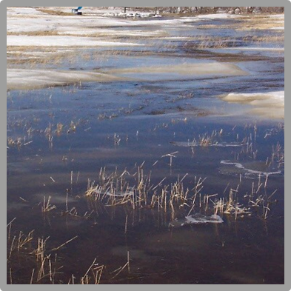
– the problem –
Images: Jane Elliott, Katy Nugent, Jeremy Hiebert (https://www.flickr.com/photos/jeremyhiebert/3698577995)
Notes:
The trick is this -- we’ve been dealt a great hand, in terms of some of the attributes of our lands for growing food – but, in terms of water quality – we’ve been dealt a lousy hand.
One of the key reasons is our lakes are often shallow – and shallow lakes are more vulnerable to problems associated with nutrients and blooms.
The other reason is some of the nature of our landscape and how nutrients move – for example large amounts of nutrients moving in snowmelt, when water is hard to control.

Slide 8
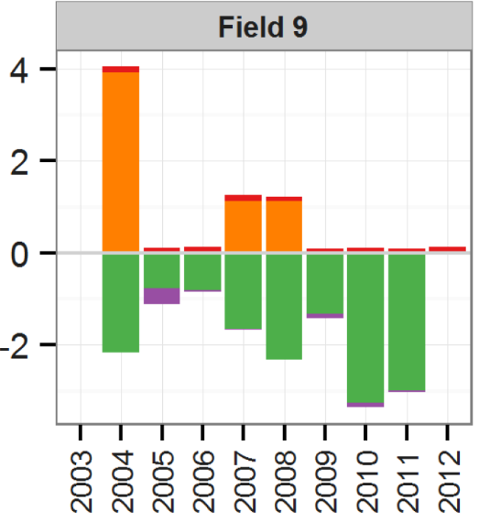
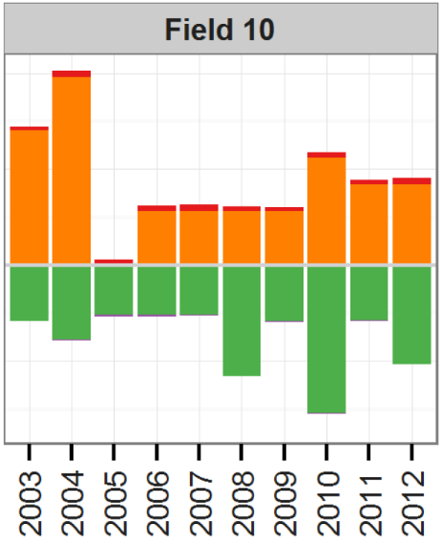
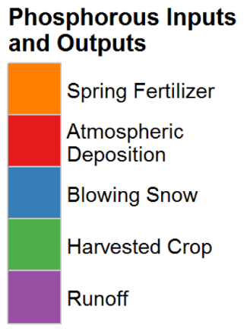
– the problem –
Recall: Most producers are already managing nutrients very carefully.
Phosphorus inputs & outputs (g/m²)
Jenn Roste
& Jane Elliott
Notes:
So focusing on the problem – but recalling that most producers are already very careful phosphorus managers –
here’s a plot that shows you that – and also highlights that this is a tough issue.
Here’s long-term data from two fields in Manitoba. Orange is the major input in spring fertilizer. Green is the major removal in harvested crop. But -- I want you to focus on the purple bar.
Aha – you can barely see the purple bar right? That’s the runoff term. It is very very small – and fertilizer inputs and removal – are much larger.
SO – runoff is a tiny proportion of the field-scale P budget.

Slide 9
– the problem –
Although runoff losses are a small proportion of field-scale nutrient budgets, these losses are enough to cause water quality problems.
Jenn Roste
& Jane Elliott
Notes:
The problem is this –
Although runoff losses are a small proportion of field-scale nutrient budgets, these losses are enough to cause water quality problems.

Slide 10

– the problem –
Solutions?
Notes:
OK, in many ways we have a tough problem.
The good news is there are solutions.

Slide 11
So what can I do?
The foundation of any solution to help mitigate agricultural nutrients is managing inputs.
Notes:
The single most important thing we need to think about is managing inputs.
So the 4Rs of right source, right rate, right time, right place are a crucial starting point.

Slide 12
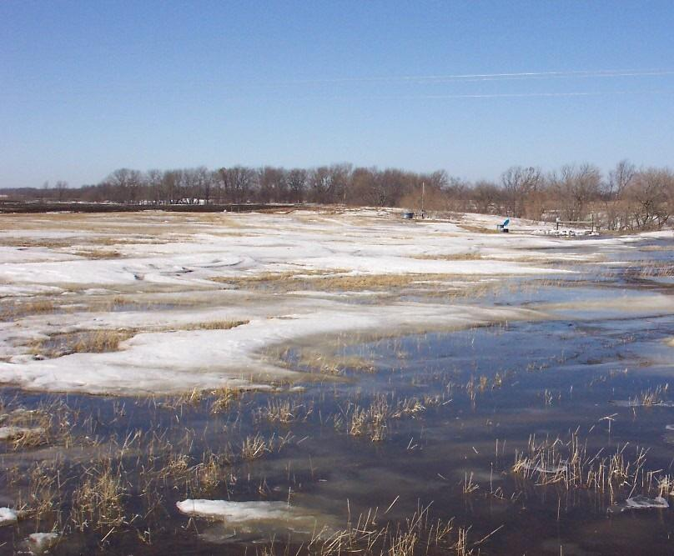
Snowmelt > 75% of runoff.
Relatively flat. Low risk of water erosion of soils.
The amount of water running off is also important.
“Keeping water on the land” can help.
Notes:
And – the importance of the four Rs as well as how we can use them most effectively – is really best understood through a lens of understanding our prairie landscapes.
First – we all know winter, and we know that snowmelt is the dominant runoff process. So that really ties into timing questions.
Any fall and winter applied manure for example – is extremely high risk for export.
Now let’s move to this point – the landscape has fairly low erosion in many areas. And because we tend to have relatively high amounts of dissolved nutrients released from soils and residues – that means most of the nutrients really move in dissolved form. Those dissolved nutrients are hard to remove and again emphasizes the importance of managing inputs in terms of place, product, and amount – being particularly careful about avoiding areas with high vulnerability to runoff. We should also be cognizant of things like phosphorus stratification in soils – which is common in reduced tillage fields, and increases phosphorus runoff.
The last point is this. The amount of water running off is also important. And our prairie hydrology is unusual, and gives us some specific opportunities. One opportunity is basically in the structure of our landscape. If we can keep water in wetlands, and small reservoirs, it can help reduce nutrient export. . The phosphorus doesn’t move when the water doesn’t move.

Slide 13
So what can I do?
The foundation of any solution to help mitigate agricultural nutrients is managing inputs.
1. Soil test – and consider both agronomy and the environment when you decide on application rates.
  Be careful in wet/connected areas.
  Also: You may want to test for phosphorus stratification in your soils.
Reduced tillage:
+ soil carbon
+ soil moisture
– water quality
Notes:
All right – so again – think about 4R nutrient management and think about it in the context of the prairies. Getting the right amount in your soils at the right time, in the right place – is important.
Consider soil testing – and as you decide on amounts, and placement – consider both agronomy, but also the environment. You may want to think differently about managing inputs in areas that are wet – and whether you can decrease P inputs that are more likely to reach streams.
It is worth noting that – in any reduced tillage fields –we see really big benefits of reduced tillage to soil moisture and soil carbon. But, the buildup of P in surface soils creates water quality concerns. You may want to test for phosphorus stratification, and consider intermittent tillage.

Slide 14
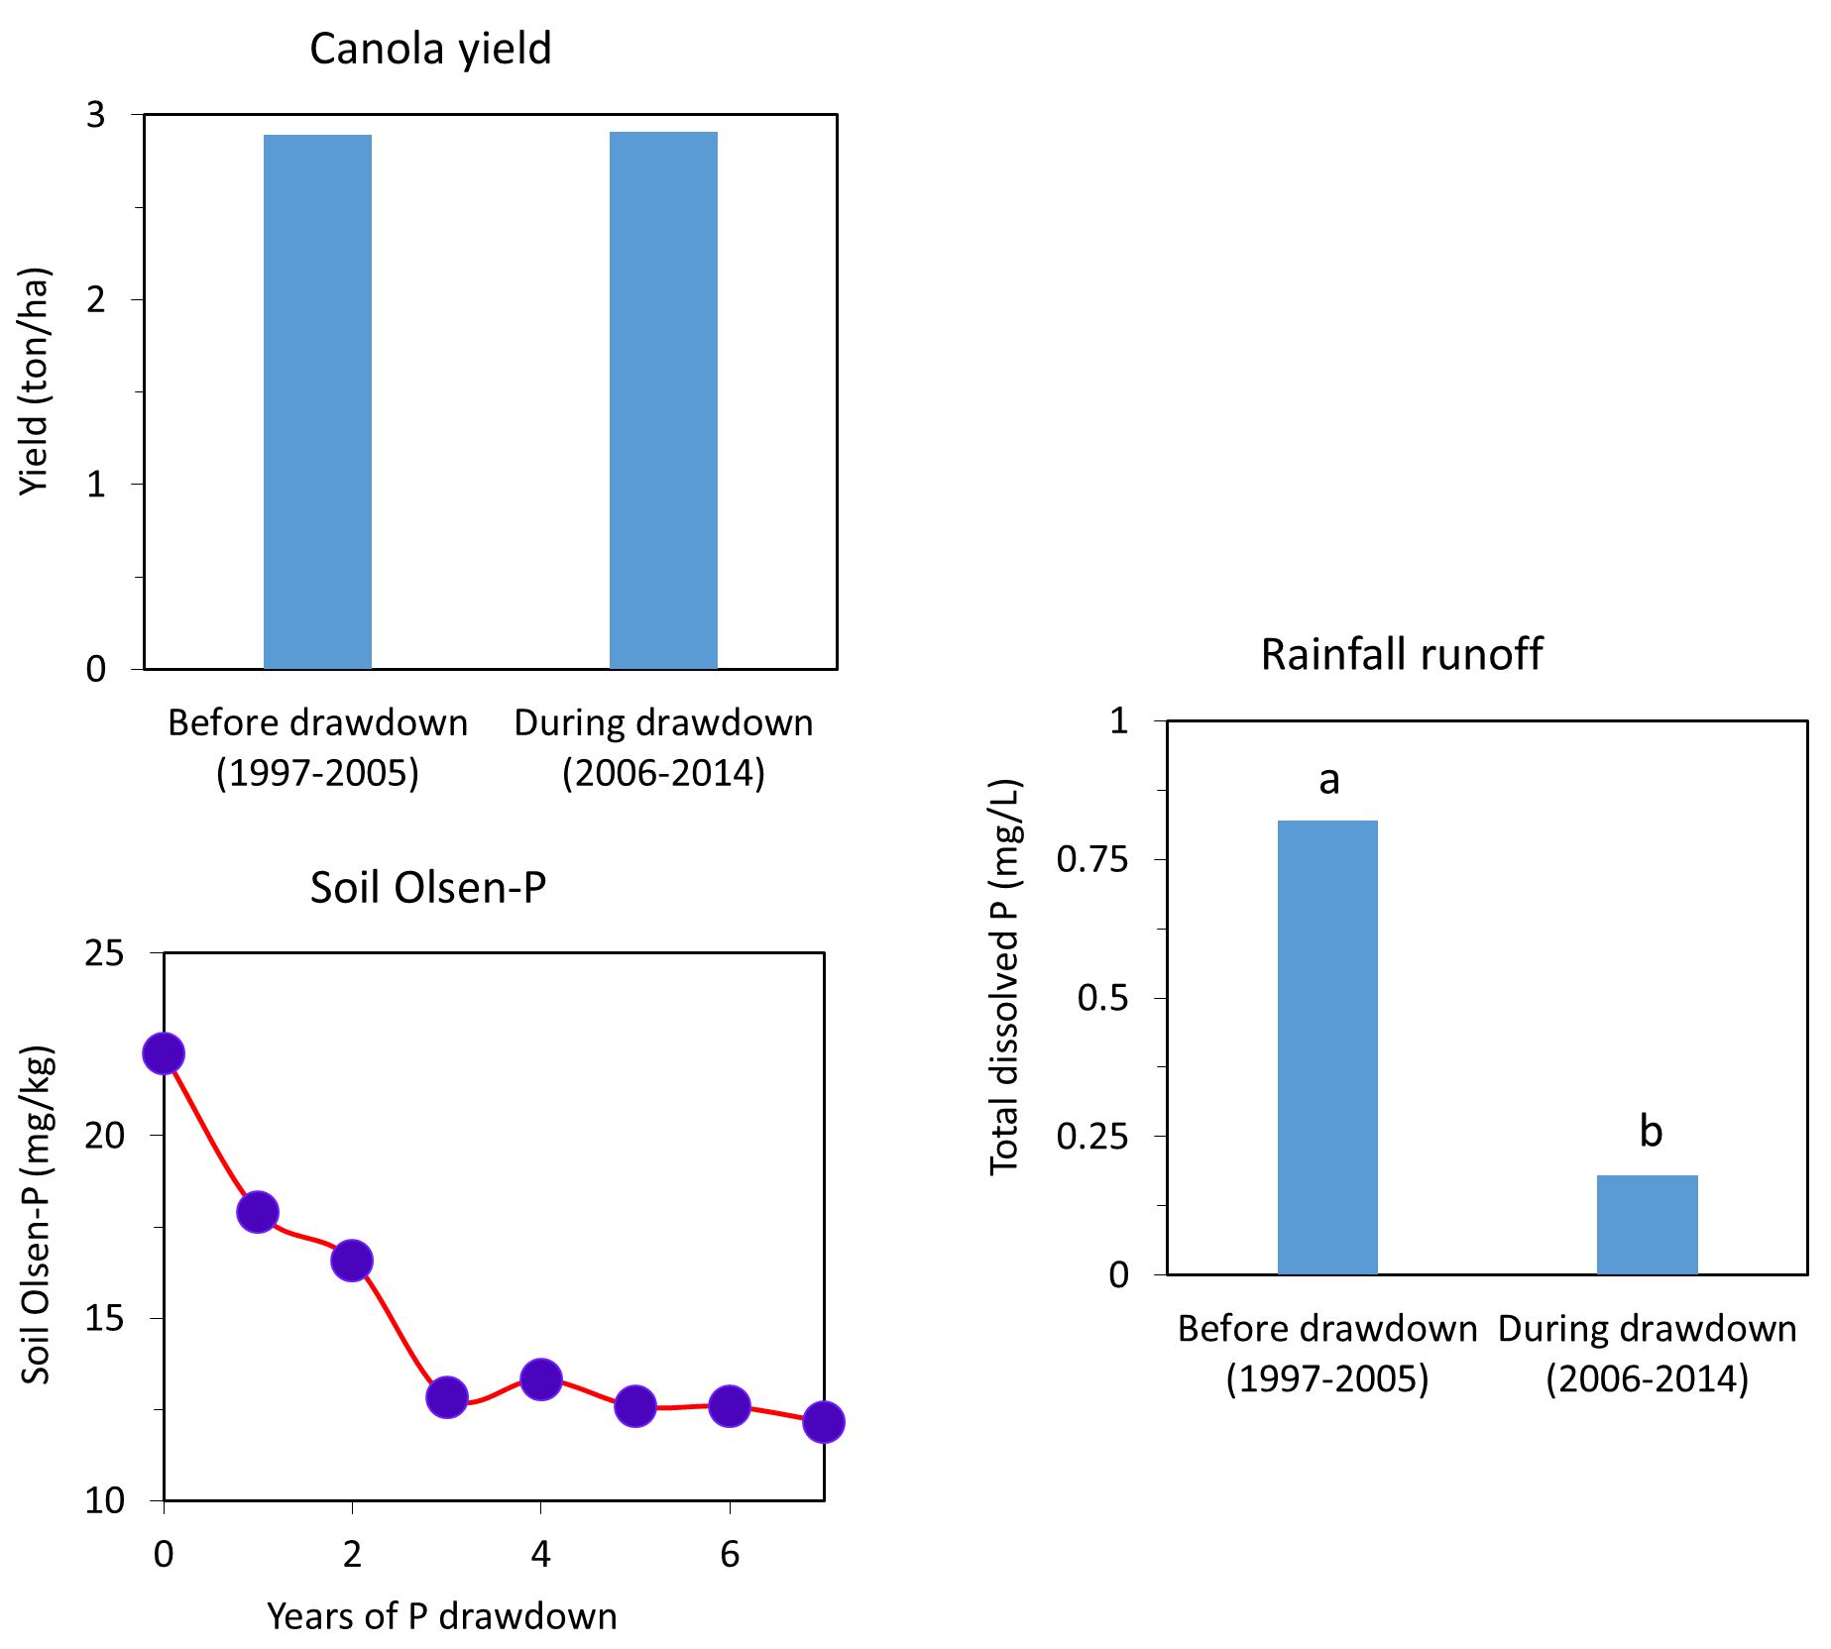
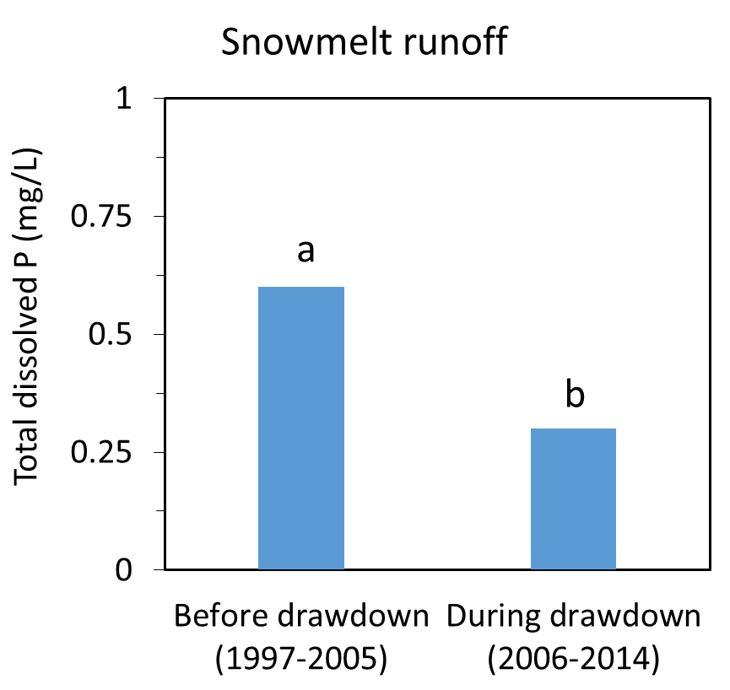
Changes in practice can lead to rapid benefits.
Liu, Elliott, Wilson, Baulch. 2019
J. Environ. Qual. doi:10.2134/jeq2018.12.0437
Notes:
It’s important to emphasize that we can see rapid benefits of changing practices to water quality. And here – we see that after a few years of work to draw down high soil P – by keeping inputs low – we’re successful. That is – we see a quick response in the soil P – and a very rapid response – with major declines in P in runoff waters. Best of all – we see yields were maintained. So – targeting areas with high soil P can definitely help solve water quality concerns and can be done in a way that also maintains high productivity.

Slide 15
So what can I do?
The foundation of any solution to help mitigate agricultural nutrients is managing inputs.
2. Don’t broadcast fertilizer,
Don’t apply manure or fertilizer in late fall or winter.
Notes:
What else can we do?
While most producers don’t apply these practices, some do. Broadcasting fertilizer and late fall and winter manure or fertilizer applications are inefficient – leading to losses in your fields, and high nutrient export – so these practices are strongly discouraged. Winter bale grazing can also be a concern depending on siting, and management.

Slide 16
So what can I do?
Managing nutrient inputs alone – probably won’t mitigate our lake problems.
3. There are many ‘other’ BMPs to consider beyond the 4Rs.
  The best implementation of best management practices requires insight of people who know the land.
Notes:
And the last point – is that – there’s a whole toolbox of practices we can and should think about – that link to the 4Rs, but also link to our understanding of how water moves on the prairies and and one important example is how we can keep water and nutrients on the land by managing runoff in wetlands, ditches and reservoirs.

Slide 17
The nutrient management toolbox for the prairies
4R nutrient management
+
Keeping water on the land
+
Image: Pixabay
Notes:
There’s a lot in these ideas– and these ideas really do best in the hands of people who know the land.

Slide 18
A few things we know.
Although runoff is episodic – snowmelt runoff is a key period where nutrients move downstream. Rainfall runoff can be important.
Phosphorus is NOT fixed in soils.
  Agricultural soils are important nutrient sources. While agronomically, losses to water don’t matter much, environmentally, there can be significant effects.
Place-based management is crucial. Producers who know their lands, and their operations know what will work.
Notes:
To close – I want to mention a few things that we do know.
While we think of the prairies as pretty dry – there is actually a fair bit of runoff in many years.
Although runoff is episodic – snowmelt runoff is a key period where nutrients move downstream. So thinking about that period, and watching how water moves helps us manage water and nutrients.
Next -- Agricultural soils and residues are really important nutrient sources to lakes and streams. There’s been a bit of a myth that P is fixed in soils . Agronomically – the P losses don’t matter – but environmentally they matter a lot. Phosphorus moves a bit more slowly than nitrate – which is why it stratifies in soils and creates problem concentrations in surface soils – but that phosphorus can definitely move downstream. Phosphorus is mobile – and minimizing its movement downstream is important to protect lakes.
And the last point – is really that producers know their lands, and what will work. It’s complex, and of course, there are many many considerations for producers in planning their operations, and lots of good practices to draw on for ideas, lots of leading producers engaging best practices to support both agronomic and environmental goals.

Slide 19
– there is a problem –
– we have some pragmatic, workable options –
Notes:
OK – so let’s come back to this initial idea.
There is a problem – and it’s a tricky one. Water quality, and blooms are worsening – impacting our recreational waters, and drinking waters but phosphorus and using phosphorus wisely is crucial to agricultural production.

Slide 20
The nutrient management toolbox for the prairies
4R nutrient management
+
Keeping water on the land
+
Image Pixabay
Notes:
The good news is -- by understanding water and nutrient movement in our landscape – and key factors such as the importance of snowmelt and mobility of soil phosphorus – we can really take best advantage of the toolbox of approaches we have to manage both nutrients and water for agriculture and the environment.

Slide 21
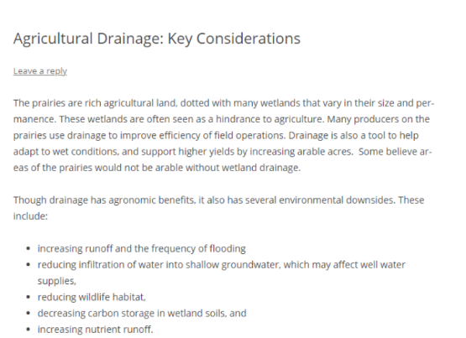

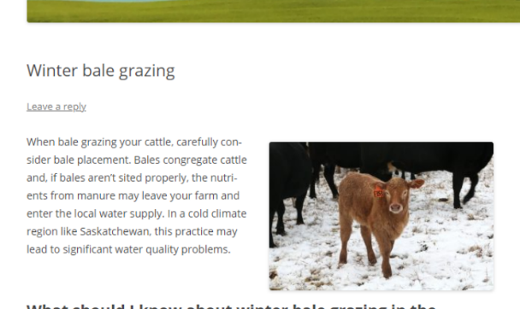
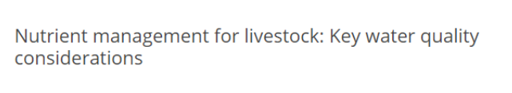
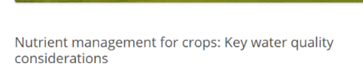


Some resources:
https://words.usask.ca/agwaterquality/
Feel free to reach out with your questions/insights:
agricultural_phosphorus@usask.ca
Notes:
Now this presentation is just an overview – and there are many resources you may want to go to. We’ve developed a blog – here with information for crop and livestock producers, as well as watershed groups. This covers things like nutrient management, bale grazing, and drainage .
We invite people to reach out with questions and insights

Slide 22





Acknowledgements
Photos and research from many sources.
Collaborators & advisors from across the prairies (including multiple universities, government agencies, producers and watershed groups).
Field, lab, technical and communications support.
Funding:
Lake Winnipeg Basin Program funding
Centennial Enhancement Chair
Notes:
And with that – I’ll acknowledge that I’m the voice on the recording – but there’s a huge network of folks who’ve built our understanding of the prairies, nutrient management issues, nutrient management solutions, and – helped on communications. This really has been built off of hundreds of conversations, meetings, and papers – as well as years of research funding from multiple sources with the hope of finding good, pragmatic solutions for agricultural production and water quality in the prairies.

Slide 23
Pragmatic workable solutions for prairie land and water.
agricultural_phosphorus@usask.ca
Images:
https://pxhere.com/en/photo/13555
https://www.flickr.com/photos/jeremyhiebert/3698577995
https://commons.wikimedia.org/wiki/File:Leney,_Saskatchewan_2015.jpg
https://commons.wikimedia.org/w/index.php?title=User:Canadaadanac&action=edit&redlink=1
KrazyTea https://commons.wikimedia.org/wiki/File:Killarney_Lake,_Manitoba_2.jpg
Notes:
Thanks for listening – I hope this has helped understand and consider nutrient solutions for prairie land and water

