Slide 1
Plain Language Introduction
Notes:
You may use any of the content on this site without explicit permission. As a federal website, the content is in the public domain. We ask only that you credit our work by citing back to PLAIN and www.plainlanguage.gov.

Slide 2
Resources
https://www.youtube.com/watch?v=KaJI-ef18ls
https://centerforplainlanguage.org/learning-training/five-steps-plain-language/
https://youtu.be/OXcLwlZOE1s
https://www.plainlanguage.gov/training/create-your-own-class/

Slide 3
What is Plain Language?
Communication that your audience or readers can understand the first time they hear or read it.

Slide 4
Plain Language Myths
Plain Language is NOT:
“Dumbing down” the concept.
Stripping out necessary terminology.
Just editorial “polishing” after you finish writing
Imprecise

Slide 5
Why Use Plain Language?
Reduce audience time trying to translate difficult, wordy documents.
Clear understanding to a wider audience.
Increase interest and engagement.
Increased use of information.
To make your message stand out.

Slide 6
Identify your audience
Think of why the audience will want to read your document
Keep in mind the audience's level of technical expertise
Write to everyone who is interested, not just to experts (focus on the 90 percent of readers in the middle of the spectrum)
Even an expert will prefer a clearly written document

Slide 7
Focus Outward On the Reader
☹ NOT… | ☺ BUT…
What do I want to say? | What does the audience need to know?
How can I focus on my interests? | How can I focus on the audience’s interests?
What can I do to impress you? | What can I clearly express to the audience?

Slide 8
Stay Focused
No one wants to read material like the next slide.

Slide 9
Coast Guard Boating Information
CO Detector Update:
The Coast Guard has conducted an investigation to determine what carbon monoxide (CO) detection devices are available to recreational boaters, such that, when installed and activated could reduce the risk of being exposed to high levels of CO -THAT SILENT KILLER. A variety of technologies is available for detecting the presence of CO on boats and should be considered by recreational boaters to reduce their risk of injury or death while boating.
(72 words)

Slide 10
Coast Guard Boating Information
Carbon monoxide is a silent killer. The Coast Guard recommends that you use a carbon monoxide detection device on your boat to reduce the risk of being exposed to high levels of CO. You may choose from a variety of devices. (39 words)

Slide 11
Plain Language and the Web
Web users scan – they don’t read. Many web pages are too dense.
Plain language helps keep web content as short and as readable as possible.
Avoid bloat! Less is more!

Slide 12
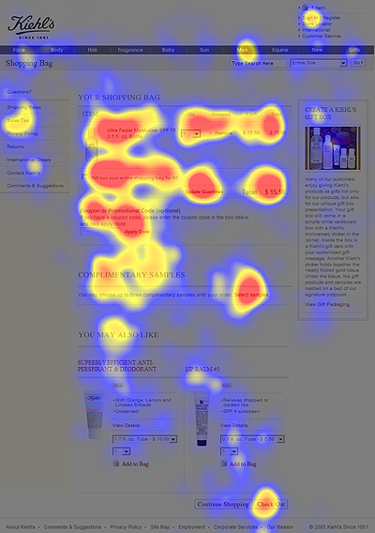
Web Writing
People read 25% slower on the Web
Cut out 50% of your text
Online readers focus on headings and bulleted list information
Image from Nielson Norman Group usability eye tracking test (2006)
12

Slide 13
Avoid Jargon
Jargon | Accessible Equitable Words
Elucidate | Clarify
Contemporaneously | At the same time
Obfuscate | Confuse
Pedagogy | Why teaching strategies are chosen
Synchronous | At the same time

Slide 14
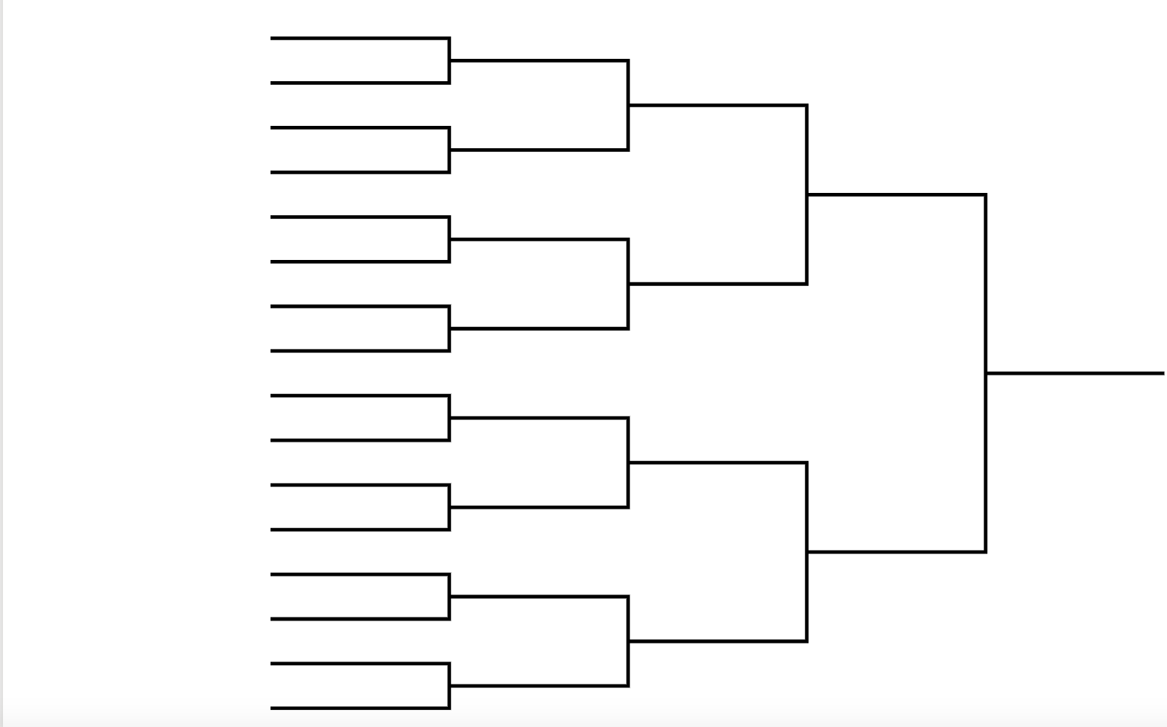
Notes:
Using the blank bracket sheet in the PPT, have the students brainstorm 16 words for contenders as the top academic jargon words used in grad studies. Type the words in the bracket sheet so the class can see.
Have students vote on each paired category, drag the words with the most votes to the next bracket, until they have the top academic jargon word for their class.
Use an online poll, such as PollEverywhere, for voting with larger classes. For smaller classes, use a show of hands.
For an added challenge, have them try not to use that word for one day.
Discussion: (5 min)
In small groups students discuss why academic words can alienate some, confuse others, and at times reflect negatively on your ability to communicate beyond academia.
Ask for a few volunteers from the small groups to share with the class.

Slide 15
What is an Equitable Phrase?
Lithodial fragments ought not to be projected by the inhabitants of vitreous abodes.

Slide 16
Simpler is Better
People who live in glass houses shouldn’t throw stones.

Slide 17
What is an Equitable Phrase?
A perissodactyl ungulate may be propelled toward a body of aqueous fluid, but such ungulate cannot be compelled or forcibly induced to imbibe such fluid.

Slide 18
Simpler is Better
You can lead a horse to water, but you can’t make him drink.

Slide 19
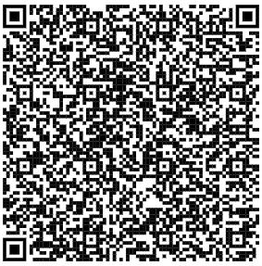
Class Exercise Option 1
Instructions:
Copy a paragraph of text from a website or from a document on your computer into a blank Microsoft Word document.
Use the spell checker to obtain a Flesch‐Kincaid Grade Level for the page. Aim for a grade 6-8 reading level.
Use the Plain Language Checklist to edit the text. Simplify, clarify, and improve the content.
Notes:
For this exercise, you may want to demonstrate this a class first before having students try this on their own.

Slide 20
Class Exercise Option 2
Instructions:
Copy a paragraph of text from a website or from a document on your computer into the Hemingway App to review the passage and use the feedback to adjust the readability. Aim for a grade 6-8 reading level.
Notes:
For this exercise, you may want to demonstrate this a class first before having students try this on their own.

Slide 21
Class Exercise Option 3
Instructions:
Have students exchange one paragraph of text from a recent writing assignment (e.g., introduction paragraph or abstract) and have a partner use either the spell checker from Microsoft Word or the Hemmingway app and the Plain Language Checklist to translate the text into plain language.
Notes:
to For this exercise, you may want to demonstrate this a class first before having students try this on their own.

Slide 22
Add Evidence to Your Portfolio
Professional Communication: Adapt communication for diverse audiences
Original Communication Document | Adapted Communication Document | Audience for Adapted Communication | What has changed and why?

Slide 23
Resources for writing in plain language
Usask Research Profile and Impact
Usask Writing Centre
NIH plain language training on the web
Plainlanguage.gov
Federal plain language guidelines
Center for Plain Language
Writing Web Content that Works, by Janice (Ginny) Redish
23

